Slide 1

Linear Integrated Circuits EE-411 L1
Dr. Syed Arsalan Jawed
Associate Professor of Practice
Office Hours : W-301, Tuesday/Thursday : 1600-1700
September 02-04, 2025
H-505
!پھربرق فروزاں ہےسر وادی سینا ، اۓدیدہ بینا
The flame of illumination set ablaze…. O’ the beholder of sight!

Slide 2
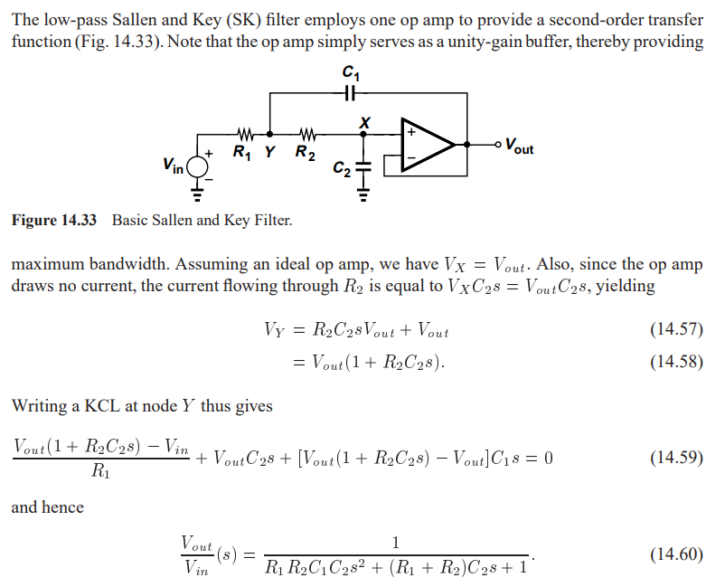
Active Second Order Filters : Sallen Key Filter

Slide 3
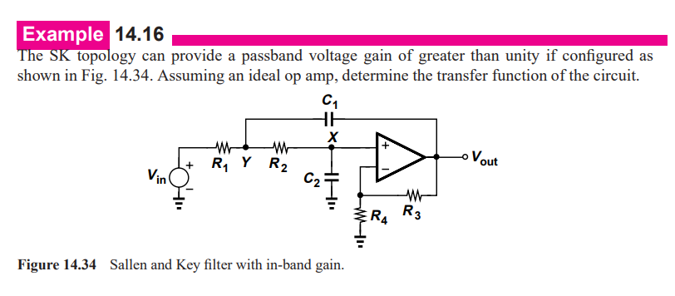
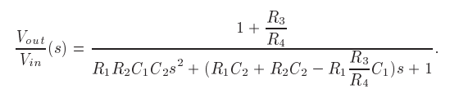

Slide 4
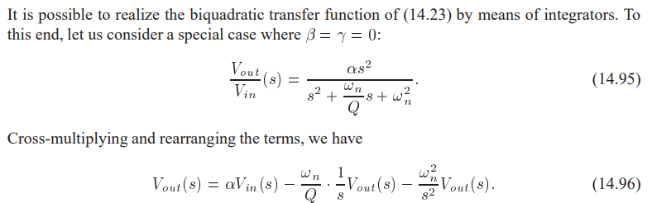
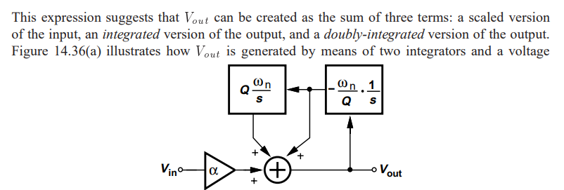
Integrator Based Biquad

Slide 5
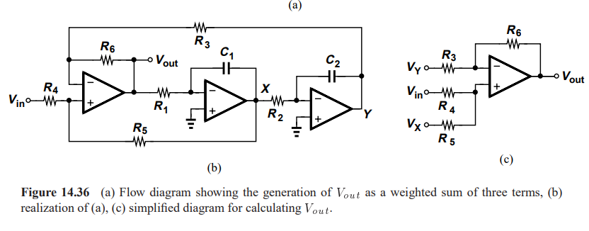

Slide 6
Next Lecture
Filter Design – Theoretical Calculations and Tool based sim in NGSPICE
So bring your devices to class.

